Slide 1
Disjoint-Set Forests

Slide 2
Outline
●
Incremental Connectivity
Maintaining connectivity as edges are added to a graph.
Disjoint-Set Forests
●
●
●
A simple data structure for incremental connectivity.
●
Union-by-Rank and Path Compression
●
Two improvements over the basic data structure.
●
Forest Slicing
●
A technique for analyzing these structures.
●
The Ackermann Inverse Function
●
An unbelievably slowly-growing function.

Slide 3
The Dynamic Connectivity Problem

Slide 4
The Connectivity Problem
The graph connectivity problem is the following:
Given an undirected graph G, preprocess the graph so that queries of the form “are nodes u and v connected?”
●

Slide 5
The Connectivity Problem
The graph connectivity problem is the following:
Given an undirected graph G, preprocess the graph so that queries of the form “are nodes u and v connected?”
●

Slide 6
The Connectivity Problem
The graph connectivity problem is the following:
Given an undirected graph G, preprocess the graph so that queries of the form “are nodes u and v connected?”
●

Slide 7
The Connectivity Problem
The graph connectivity problem is the following:
Given an undirected graph G, preprocess the graph so that queries of the form “are nodes u and v connected?”
●

Slide 8
The Connectivity Problem
The graph connectivity problem is the following:
Given an undirected graph G, preprocess the graph so that queries of the form “are nodes u and v connected?”
Using Θ(m + n) preprocessing, can preprocess the graph to answer queries in time O(1).
●
●

Slide 9
The Connectivity Problem
The graph connectivity problem is the following:
Given an undirected graph G, preprocess the graph so that queries of the form “are nodes u and v connected?”
Using Θ(m + n) preprocessing, can preprocess the graph to answer queries in time O(1).
●
●
0 2 2
1 3
1 3
0
2
0
2
2
0
0
3
3
2

Slide 10
The Connectivity Problem
The graph connectivity problem is the following:
Given an undirected graph G, preprocess the graph so that queries of the form “are nodes u and v connected?”
Using Θ(m + n) preprocessing, can preprocess the graph to answer queries in time O(1).
●
●
0 2 2
1 3
1 3
0
2
0
2
2
0
0
3
3
2

Slide 11
The Connectivity Problem
The graph connectivity problem is the following:
Given an undirected graph G, preprocess the graph so that queries of the form “are nodes u and v connected?”
Using Θ(m + n) preprocessing, can preprocess the graph to answer queries in time O(1).
●
●
0 2 2
1 3
1 3
0
2
0
2
2
0
0
3
3
2

Slide 12
Dynamic Connectivity
The dynamic connectivity problem is the following:
Maintain an undirected graph G so that edges may be inserted an deleted and connectivity queries may be answered efficiently.
This is a much harder problem!
●
●

Slide 13
Dynamic Connectivity
The dynamic connectivity problem is the following:
Maintain an undirected graph G so that edges may be inserted an deleted and connectivity queries may be answered efficiently.
This is a much harder problem!
●
●

Slide 14
Dynamic Connectivity
The dynamic connectivity problem is the following:
Maintain an undirected graph G so that edges may be inserted an deleted and connectivity queries may be answered efficiently.
This is a much harder problem!
●
●

Slide 15
Dynamic Connectivity
The dynamic connectivity problem is the following:
Maintain an undirected graph G so that edges may be inserted an deleted and connectivity queries may be answered efficiently.
This is a much harder problem!
●
●

Slide 16
Dynamic Connectivity
The dynamic connectivity problem is the following:
Maintain an undirected graph G so that edges may be inserted an deleted and connectivity queries may be answered efficiently.
This is a much harder problem!
●
●

Slide 17
Dynamic Connectivity
The dynamic connectivity problem is the following:
Maintain an undirected graph G so that edges may be inserted an deleted and connectivity queries may be answered efficiently.
This is a much harder problem!
●
●

Slide 18
Dynamic Connectivity
The dynamic connectivity problem is the following:
Maintain an undirected graph G so that edges may be inserted an deleted and connectivity queries may be answered efficiently.
This is a much harder problem!
●
●

Slide 19
Dynamic Connectivity
The dynamic connectivity problem is the following:
Maintain an undirected graph G so that edges may be inserted an deleted and connectivity queries may be answered efficiently.
This is a much harder problem!
●
●

Slide 20
Dynamic Connectivity
The dynamic connectivity problem is the following:
Maintain an undirected graph G so that edges may be inserted an deleted and connectivity queries may be answered efficiently.
This is a much harder problem!
●
●

Slide 21
Dynamic Connectivity
The dynamic connectivity problem is the following:
Maintain an undirected graph G so that edges may be inserted an deleted and connectivity queries may be answered efficiently.
This is a much harder problem!
●
●

Slide 22
Dynamic Connectivity
The dynamic connectivity problem is the following:
Maintain an undirected graph G so that edges may be inserted an deleted and connectivity queries may be answered efficiently.
This is a much harder problem!
●
●

Slide 23
Dynamic Connectivity
The dynamic connectivity problem is the following:
Maintain an undirected graph G so that edges may be inserted an deleted and connectivity queries may be answered efficiently.
This is a much harder problem!
●
●

Slide 24
Dynamic Connectivity
The dynamic connectivity problem is the following:
Maintain an undirected graph G so that edges may be inserted an deleted and connectivity queries may be answered efficiently.
This is a much harder problem!
●
●

Slide 25
Dynamic Connectivity
The dynamic connectivity problem is the following:
Maintain an undirected graph G so that edges may be inserted an deleted and connectivity queries may be answered efficiently.
This is a much harder problem!
●
●

Slide 26
Dynamic Connectivity
The dynamic connectivity problem is the following:
Maintain an undirected graph G so that edges may be inserted an deleted and connectivity queries may be answered efficiently.
This is a much harder problem!
●
●

Slide 27
Dynamic Connectivity
The dynamic connectivity problem is the following:
Maintain an undirected graph G so that edges may be inserted an deleted and connectivity queries may be answered efficiently.
This is a much harder problem!
●
●

Slide 28
Dynamic Connectivity
The dynamic connectivity problem is the following:
Maintain an undirected graph G so that edges may be inserted an deleted and connectivity queries may be answered efficiently.
This is a much harder problem!
●
●

Slide 29
Dynamic Connectivity
The dynamic connectivity problem is the following:
Maintain an undirected graph G so that edges may be inserted an deleted and connectivity queries may be answered efficiently.
This is a much harder problem!
●
●

Slide 30
Dynamic Connectivity
The dynamic connectivity problem is the following:
Maintain an undirected graph G so that edges may be inserted an deleted and connectivity queries may be answered efficiently.
This is a much harder problem!
●
●

Slide 31
Dynamic Connectivity
The dynamic connectivity problem is the following:
Maintain an undirected graph G so that edges may be inserted an deleted and connectivity queries may be answered efficiently.
This is a much harder problem!
●
●

Slide 32
Dynamic Connectivity
The dynamic connectivity problem is the following:
Maintain an undirected graph G so that edges may be inserted an deleted and connectivity queries may be answered efficiently.
This is a much harder problem!
●
●

Slide 33
Dynamic Connectivity
The dynamic connectivity problem is the following:
Maintain an undirected graph G so that edges may be inserted an deleted and connectivity queries may be answered efficiently.
This is a much harder problem!
●
●

Slide 34
Dynamic Connectivity
Today, we'll focus on the incremental dynamic connectivity problem: maintaining connectivity when edges can only be added, not deleted.
Has applications to Kruskal's MST algorithm and to many other online connectivity settings.
●
●
●
Look up percolation theory for an example.
●
These data structures are also used as building blocks in other algorithms:
●
Speeding up Edmond's blossom algorithm for finding maximum matchings.
As a subroutine in Tarjan's offline lowest common ancestors algorithm.
Building meldable priority queues out of non-meldable queues.
●
●

Slide 35
Incremental Connectivity and Partitions

Slide 36
Set Partitions
The incremental connectivity problem is equivalent to maintaining a partition of a set.
Initially, each node belongs to its own set.
As edges are added, the sets at the endpoints become connected and are merged together.
Querying for connectivity is equivalent to querying for whether two elements belong to the same set.

Slide 37






Representatives
Given a partition of a set S, we can choose one representative from each of the sets in the partition.
Representatives give a simple proxy for which set an element belongs to: two elements are in the same set in the partition iff their set has the same representative.

Slide 38




Representatives
Given a partition of a set S, we can choose one representative from each of the sets in the partition.
Representatives give a simple proxy for which set an element belongs to: two elements are in the same set in the partition iff their set has the same representative.

Slide 39
Union-Find Structures
A union-find structure is a data structure supporting the following operations:
  find(x), which returns the representative of the set containing node x, and
  union(x, y), which merges the sets containing x and y into a single set.
We'll focus on these sorts of structures as a solution to incremental connectivity.

Slide 40
Data Structure Idea
Idea: Have each element store a pointer directly to its representative.
To determine if two nodes are in the same set, check if they have the same representative.
To link two sets together, change all elements of the two sets so they reference a single representative.

Slide 41
Using Representatives

Slide 42
Using Representatives

Slide 43


Using Representatives

Slide 44
Using Representatives

Slide 45
Using Representatives

Slide 46
Using Representatives

Slide 47


Using Representatives

Slide 48
Using Representatives

Slide 49

Using Representatives

Slide 50
Using Representatives

Slide 51




Using Representatives

Slide 52
Using Representatives

Slide 53




Using Representatives

Slide 54
Using Representatives
If we update all the representative pointers in a set when doing a union, we may spend time O(n) per union operation.
  If you're clever with how you change the pointers, you can make it amortized O(log n) per operation. Do you see how?
Can we avoid paying this cost?

Slide 55


Hierarchical Representatives

Slide 56
Hierarchical Representatives

Slide 57


Hierarchical Representatives

Slide 58
Hierarchical Representatives

Slide 59
Hierarchical Representatives

Slide 60
Hierarchical Representatives

Slide 61



Hierarchical Representatives

Slide 62
Hierarchical Representatives

Slide 63
Hierarchical Representatives

Slide 64
Hierarchical Representatives

Slide 65
Hierarchical Representatives

Slide 66
Hierarchical Representatives
In a degenerate case, a hierarchical representative approach will require time Θ(n) for some find operations.
Therefore, some union operations will take time Θ(n) as well.
Can we avoid these degenerate cases?

Slide 67
Union by Rank

Slide 68
Union by Rank
 | 0 |  | 0 |  | 0 |  | 0
 | 0 |  | 0 |  | 0 |  | 0
 |  |  | 0 |  | 0

Slide 69
Union by Rank
 | 0 |  | 0 |  | 0 |  | 0
 | 0 |  | 0 |  | 0 |  | 0
 |  |  | 0 |  | 0

Slide 70


Union by Rank
0
0
0
0
0
1
0
0
0
0

Slide 71
Union by Rank
0
0
0
0
0
1
0
0
0
0

Slide 72
Union by Rank
0
0
0
0
0
1
0
0
0
0

Slide 73
Union by Rank
0
0
1
0
0
1
0
0
0
0

Slide 74
Union by Rank
0
0
1
0
0
1
0
0
0
0

Slide 75
Union by Rank
0
0
1
0
0
1
0
0
0
0

Slide 76



Union by Rank
0
0
1
0
0
1
0
0
0
0

Slide 77
Union by Rank
0
0
1
0
0
1
0
0
0
0

Slide 78
Union by Rank
0
0
1
0
0
1
0
0
0
0

Slide 79




Union by Rank
0
0
1
0
0
1
0
0
0
0

Slide 80
Union by Rank
0
0
1
0
0
1
0
0
0
0

Slide 81
Union by Rank
0
0
1
0
0
1
0
0
0
0

Slide 82
Union by Rank
0
0
1
0
1
1
0
0
0
0

Slide 83
Union by Rank
0
0
1
0
1
1
0
0
0
0

Slide 84
Union by Rank
0
0
1
0
1
1
0
0
0
0

Slide 85




Union by Rank
0
0
1
0
1
2
0
0
0
0

Slide 86
Union by Rank
0
0
1
0
1
2
0
0
0
0

Slide 87
Union by Rank
0
0
1
0
1
2
0
0
0
0

Slide 88



Union by Rank
0
0
1
0
1
2
0
0
0
0

Slide 89
Union by Rank
0
0
1
0
1
2
0
0
0
0

Slide 90
Union by Rank
Assign to each node a rank that is initially zero.
To link two trees, link the tree of the smaller rank to the tree of the larger rank.
If both trees have the same rank, link one to the other and increase the rank of the other tree by one.

Slide 91
Union by Rank
●
Claim: The number of nodes in a tree of rank r is at least 2^{r}.
●
Proof is by induction; intuitively, need to double the size to get to a tree of the next order.
Fun fact: the smallest tree with a root of rank r is a binomial tree of order r. Crazy!
●
●
Claim: Maximum rank of a node in a graph with n
nodes is O(log n).
Runtime for union and find is now O(log n).
Useful fact for later on: The number of nodes of rank r or higher in a disjoint set forest with n nodes is at most n / 2^{r}.
●
●

Slide 92
Path Compression
0
0
1
0
1
2
0
0
0
0

Slide 93
Path Compression
0
0
1
0
1
2
0
0
0
0

Slide 94


Path Compression
0
0
1
0
1
2
0
0
0
0

Slide 95

Path Compression
0
0
1
0
1
2
0
0
0
0

Slide 96
Path Compression
0
0
1
0
1
2
0
0
0
0

Slide 97


Path Compression
0
0
1
0
1
2
0
0
0
0

Slide 98

Path Compression
0
0
1
0
1
2
0
0
0
0

Slide 99
Path Compression
0
0
1
0
1
2
0
0
0
0

Slide 100
Path Compression
Path compression is an optimization to the standard disjoint-set forest.
When performing a find, change the parent pointers of each node found along the way to point to the representative.
Purely using path compression, each operation has amortized cost O(log n).
What happens if we combine this with union- by-rank?

Slide 101
Continue …
Reading Assignment

Slide 102
The Claim
Claim: The runtime of performing m union and find operations on an n-node disjoint-set forest using path compression and union-by-rank is O(n + mα(n)), where α is an extremely slowly-growing function.
The original proof of this result (which is included in CLRS) is due to Tarjan and uses a complex amortized charging scheme.
Today, we'll use an an aggregate analysis due to Seidel and Sharir based on a technique called forest- slicing.

Slide 103
Where We're Going
●
First, we're going to define our cost model so we know how to analyze the structure.
Next, we'll introduce the forest-slicing approach and use it to prove a key lemma.
Finally, we'll use that lemma to build recurrence relations that analyze the runtime.
●
●

Slide 104
Our Cost Model
●
The cost of performing a union or find depends on the length of the paths followed.
The cost of any one operation is
Θ(1 + #ptr-changes-made) because each time we visit a node that doesn't
immediately point to its representative, we change
where it points.
Therefore, the cost of m operations is
Θ(m + #ptr-changes-made)
We will analyze the number of pointers changed across the life of the data structure to bound the overall cost.
●
●
●

Slide 105
Some Accounting Tricks
●
To perform a union operation, we need to first perform two finds.
After that, only O(1) time is required to perform the union operation.
Therefore, we can replace each union(x, y) with three operations:
●
●
A call to find(x). A call to find(y).
A linking step between the nodes found this way.
●
●
●
●
Going forward, we will assume that each union
operation will take worst-case time O(1).

Slide 106
A Slight Simplification
●
Currently, find(x) compresses from x up to its ancestor.
For mathematical simplicity, we'll introduce an operation compress(x, y) that compresses from x upward to y, assuming that y is an ancestor of x.
Our analysis will then try to bound the total cost of the compress operations.
●
●

Slide 107
Removing the Interleaving
●
We will run into some trouble in our analysis because unions and compresses can be interleaved.
To address this, we will will remove the interleaving by pretending that all unions come before all compresses.
This does not change the overall work being done.
●
●

Slide 108
Removing the Interleaving
a
b
c
d
e
f
g
h
i
j

Slide 109
Removing the Interleaving
a
find(j) union(b, a) find(h)
b
c
d
e
f
g
h
i
j

Slide 110
Removing the Interleaving
a
find(j) union(b, a) find(h)
b
c
d
e
f
g
h
i
j

Slide 111
Removing the Interleaving
a
compress(j, b) union(b, a) find(h)
b
c
d
e
f
g
h
i
j

Slide 112
Removing the Interleaving
a
compress(j, b) union(b, a) find(h)
b
c
d
e f h j
g
i

Slide 113
Removing the Interleaving
a
compress(j, b) union(b, a) find(h)
b
c
d
f → b h → b j → b
e f h j
g
i

Slide 114
Removing the Interleaving
a
compress(j, b) union(b, a) find(h)
b
c
d
f → b h → b j → b
e f h j
g
i

Slide 115
Removing the Interleaving
a
compress(j, b) union(b, a) find(h)
b
c
d
f → b h → b j → b
e f h j
g
i

Slide 116
Removing the Interleaving
a
compress(j, b) union(b, a) find(h)
b
c
d
f → b h → b j → b b → a
e f h j
g
i

Slide 117
Removing the Interleaving
a
compress(j, b) union(b, a) find(h)
b
c
d
f → b h → b j → b b → a
e f h j
g
i

Slide 118
Removing the Interleaving
a
compress(j, b) union(b, a) compress(h, a)
b
c
d
f → b h → b j → b b → a
e f h j
g
i

Slide 119
Removing the Interleaving
a
compress(j, b) union(b, a) compress(h, a)
b
h c
d
f → b h → b j → b b → a
e f
j
g
i

Slide 120
Removing the Interleaving
a
compress(j, b) union(b, a) compress(h, a)
b
h c
d
f → b h → b j → b b → a h → a
e f
j
g
i

Slide 121
Removing the Interleaving
a
compress(j, b) union(b, a) compress(h, a)
b
h c
d
f → b h → b j → b b → a h → a
e f
j
g
i

Slide 122
Removing the Interleaving
compress(j, b) union(b, a) compress(h, a)
f → b h → b j → b b → a h → a

Slide 123
Removing the Interleaving
a
compress(j, b) union(b, a) compress(h, a)
b
c
d
f → b h → b j → b b → a h → a
e
f
g
h
i
j

Slide 124
Removing the Interleaving
a
compress(j, b) union(b, a) compress(h, a)
union(b, a) compress(j, b) compress(h, a)
b
c
d
f → b h → b j → b b → a h → a
e
f
g
h
i
j

Slide 125
Removing the Interleaving
a
compress(j, b) union(b, a) compress(h, a)
union(b, a) compress(j, b) compress(h, a)
b
c
d
f → b h → b j → b b → a h → a
e
f
g
h
i
j

Slide 126
Removing the Interleaving
a
compress(j, b) union(b, a) compress(h, a)
union(b, a) compress(j, b) compress(h, a)
b
c
d
f → b h → b j → b b → a h → a
b → a
e
f
g
h
i
j

Slide 127
Removing the Interleaving
a
compress(j, b) union(b, a) compress(h, a)
union(b, a) compress(j, b) compress(h, a)
b
c
d
f → b h → b j → b b → a h → a
b → a
e
f
g
h
i
j

Slide 128
Removing the Interleaving
a
compress(j, b) union(b, a) compress(h, a)
union(b, a) compress(j, b) compress(h, a)
b
c
d
f → b h → b j → b b → a h → a
b → a
e f h j
g
i

Slide 129
Removing the Interleaving
a
compress(j, b) union(b, a) compress(h, a)
union(b, a) compress(j, b) compress(h, a)
b
c
d
f → b h → b j → b b → a h → a
b → a f → b h → b j → b
e f h j
g
i

Slide 130
Removing the Interleaving
a
compress(j, b) union(b, a) compress(h, a)
union(b, a) compress(j, b) compress(h, a)
b
c
d
f → b h → b j → b b → a h → a
b → a f → b h → b j → b
e f h j
g
i

Slide 131
Removing the Interleaving
a
compress(j, b) union(b, a) compress(h, a)
union(b, a) compress(j, b) compress(h, a)
b
c
d
f → b h → b j → b b → a h → a
b → a f → b h → b j → b
e f h j
g
i

Slide 132
Removing the Interleaving
a
compress(j, b) union(b, a) compress(h, a)
union(b, a) compress(j, b) compress(h, a)
b
h c
d
f → b h → b j → b b → a h → a
b → a f → b h → b j → b
e f
j
g
i

Slide 133
Removing the Interleaving
a
compress(j, b) union(b, a) compress(h, a)
union(b, a) compress(j, b) compress(h, a)
b
h c
d
f → b h → b j → b b → a h → a
b → a f → b h → b j → b h → a
e f
j
g
i

Slide 134
Removing the Interleaving
a
compress(j, b) union(b, a) compress(h, a)
union(b, a) compress(j, b) compress(h, a)
b
h c
d
f → b h → b j → b b → a h → a
b → a f → b h → b j → b h → a
e f
j
g
i

Slide 135
Recap: The Setup
●
Transform any sequence of unions and finds as follows:
●
Replace all union operations with two finds and a
union on the ancestors.
Replace each find operation with a compress
operation indicating its start and end nodes.
Move all union operations to the front.
●
●
●
Since all unions are at the front, we build the entire forest before we begin compressing.
Can analyze compress assuming the forest has already been created for us.
●

Slide 136
A Quick Initial Analysis

Slide 137
An Initial Analysis
●
Lemma: Any series of m compress operation on a forest ℱ with
n nodes and maximum rank r makes at most nr pointer changes.
Proof: Every time a node's representative change, the rank of that representative increases. The maximum number of times this can happen per node is r, giving an upper bound of nr. ■
3 3
●
2
2
1
1
1
1
0
0
0
0
0
0
0
0
0

Slide 138
The Forest-Slicing Approach

Slide 139
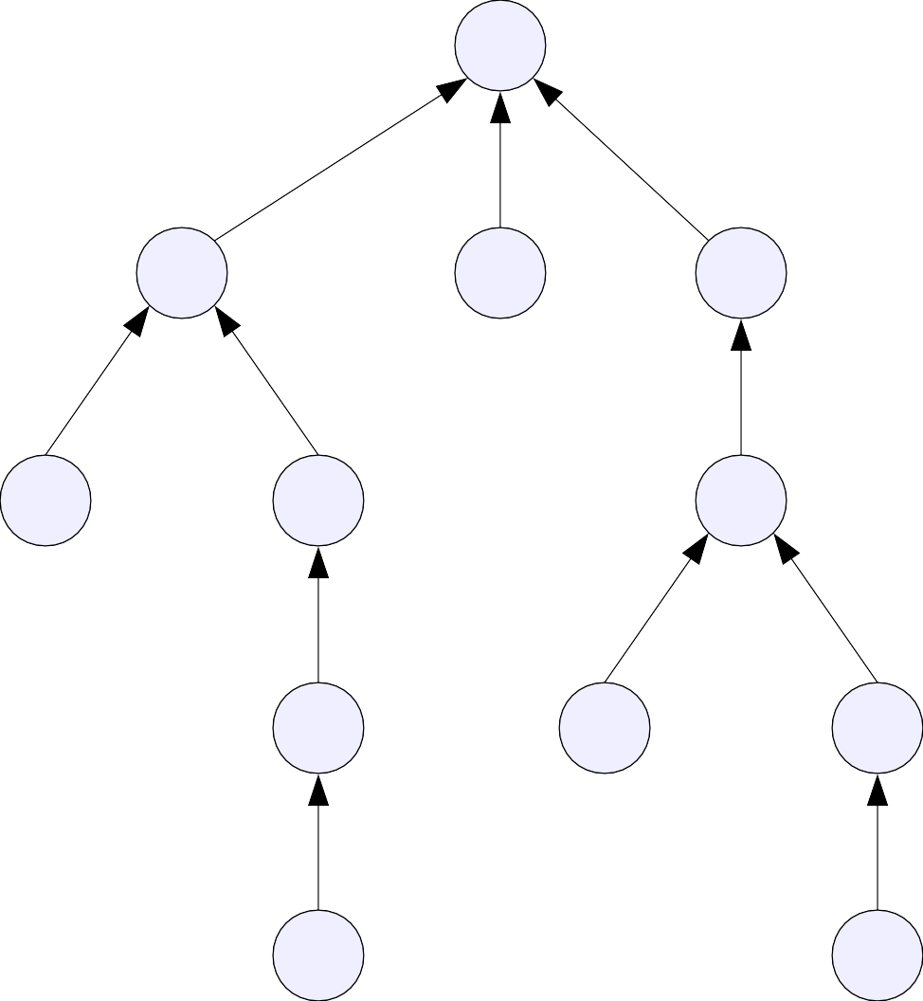
Forest-Slicing
a
b
c
d
e
f
g
h
i
j
k
l

Slide 140
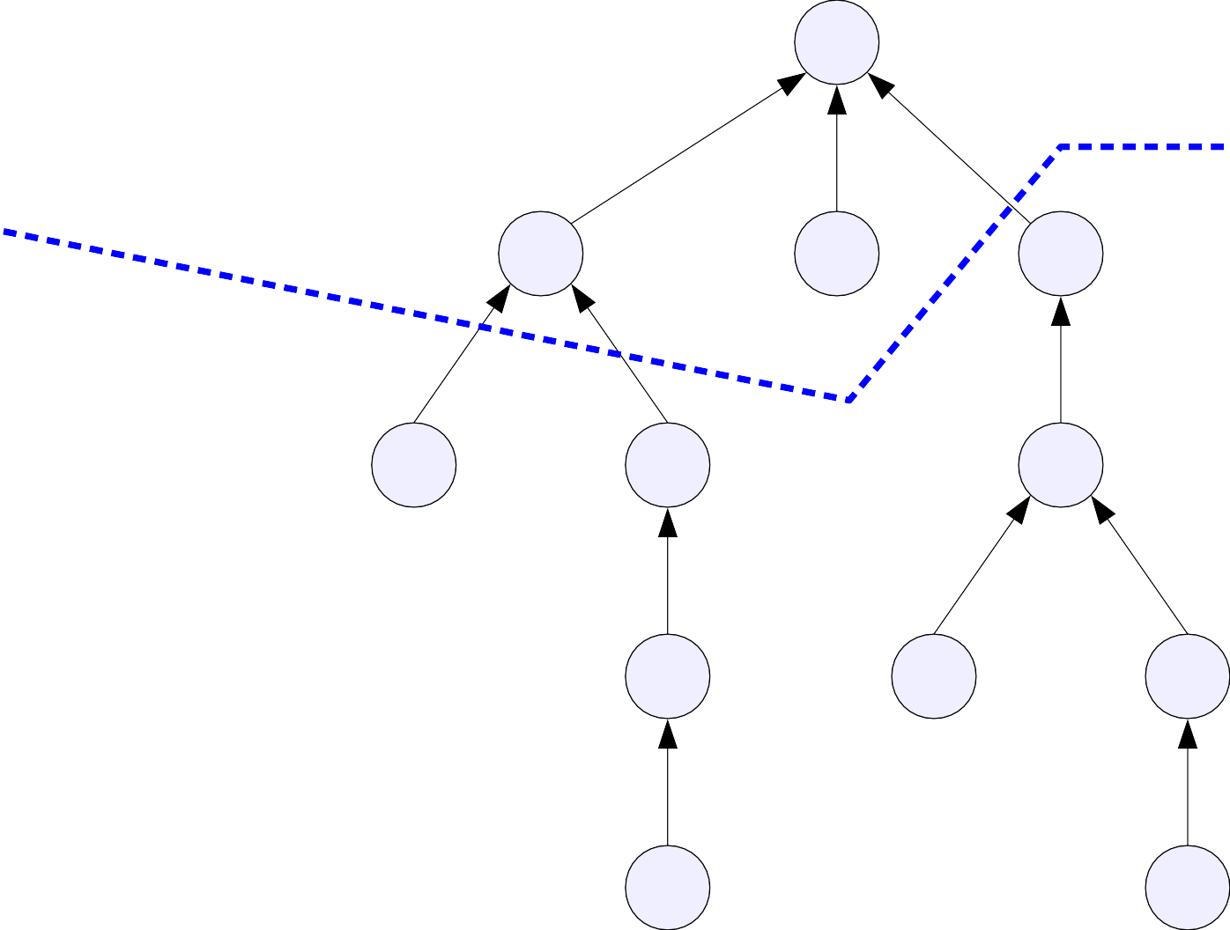
Forest-Slicing
a
b
c
d
e
f
g
h
i
j
k
l

Slide 141
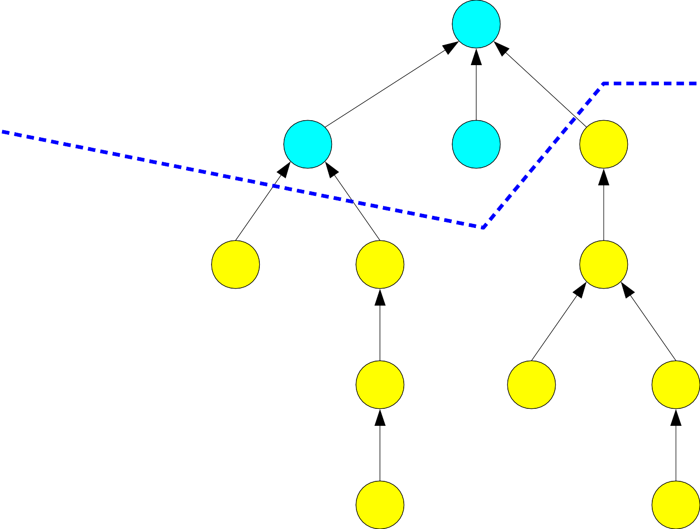
Forest-Slicing
a
b
c
d
e
f
g
h
i
j
k
l

Slide 142
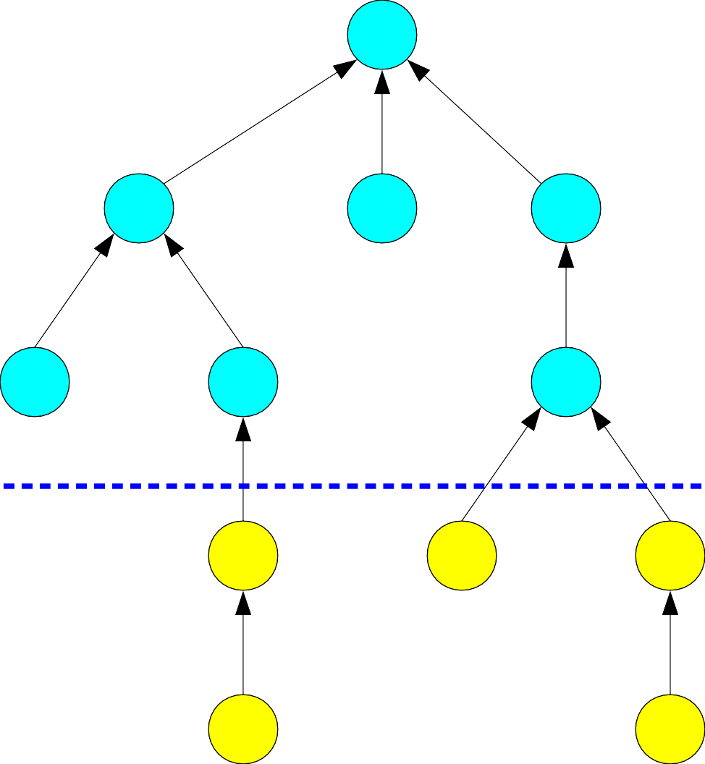
Forest-Slicing
a
b
c
d
e
f
g
h
i
j
k
l

Slide 143
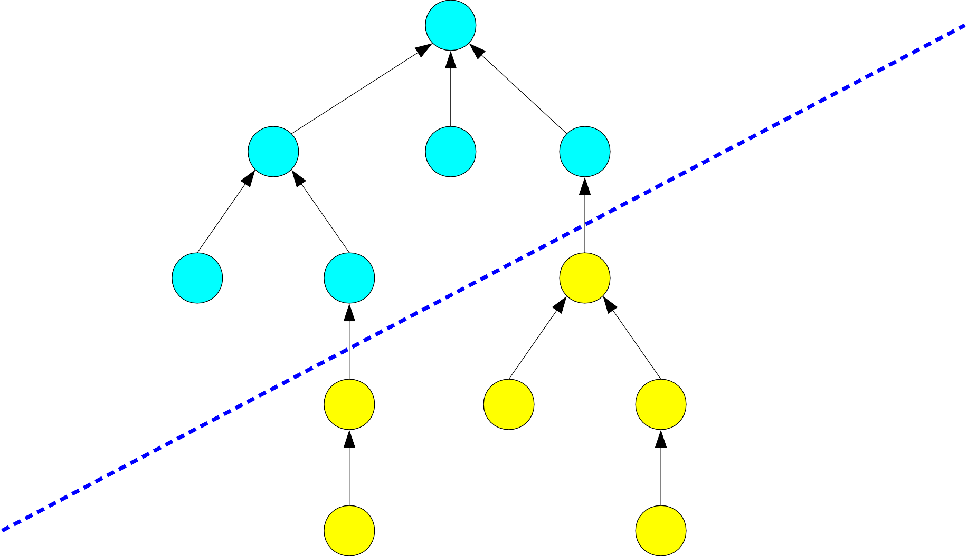
Forest-Slicing
a
b
c
d
e
f
g
h
i
j
k
l

Slide 144
Forest-Slicing
Let ℱ be a disjoint-set forest.
Consider splitting ℱ into two forests ℱ₊ and ℱ₋ with the following properties:
●
●
●
ℱ₊ is upward-closed: if x ∈ ℱ₊, then any ancestor of x is also in ℱ₊.
ℱ₋ is downward-closed: if x ∈ ℱ₋, then any descendant of x is also in ℱ₋.
●
●
We'll call ℱ₊ the top forest and ℱ₋ the
bottom forest.

Slide 145
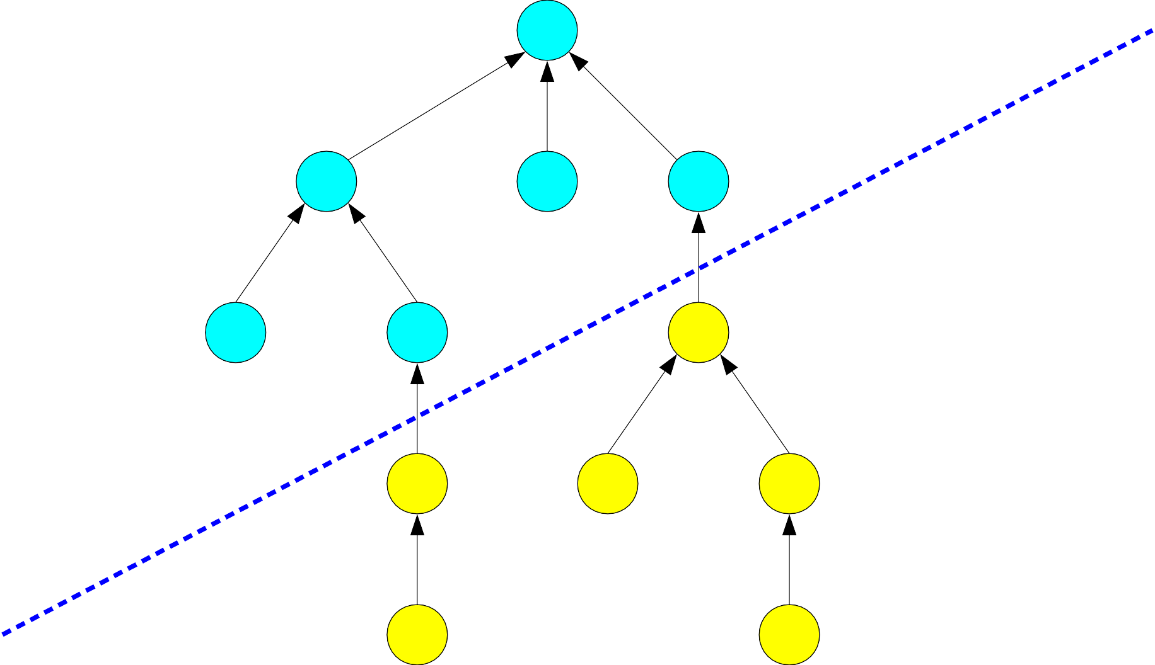
Forest-Slicing
a
b
c
d
e
f
g
h
i
j
k
l

Slide 146
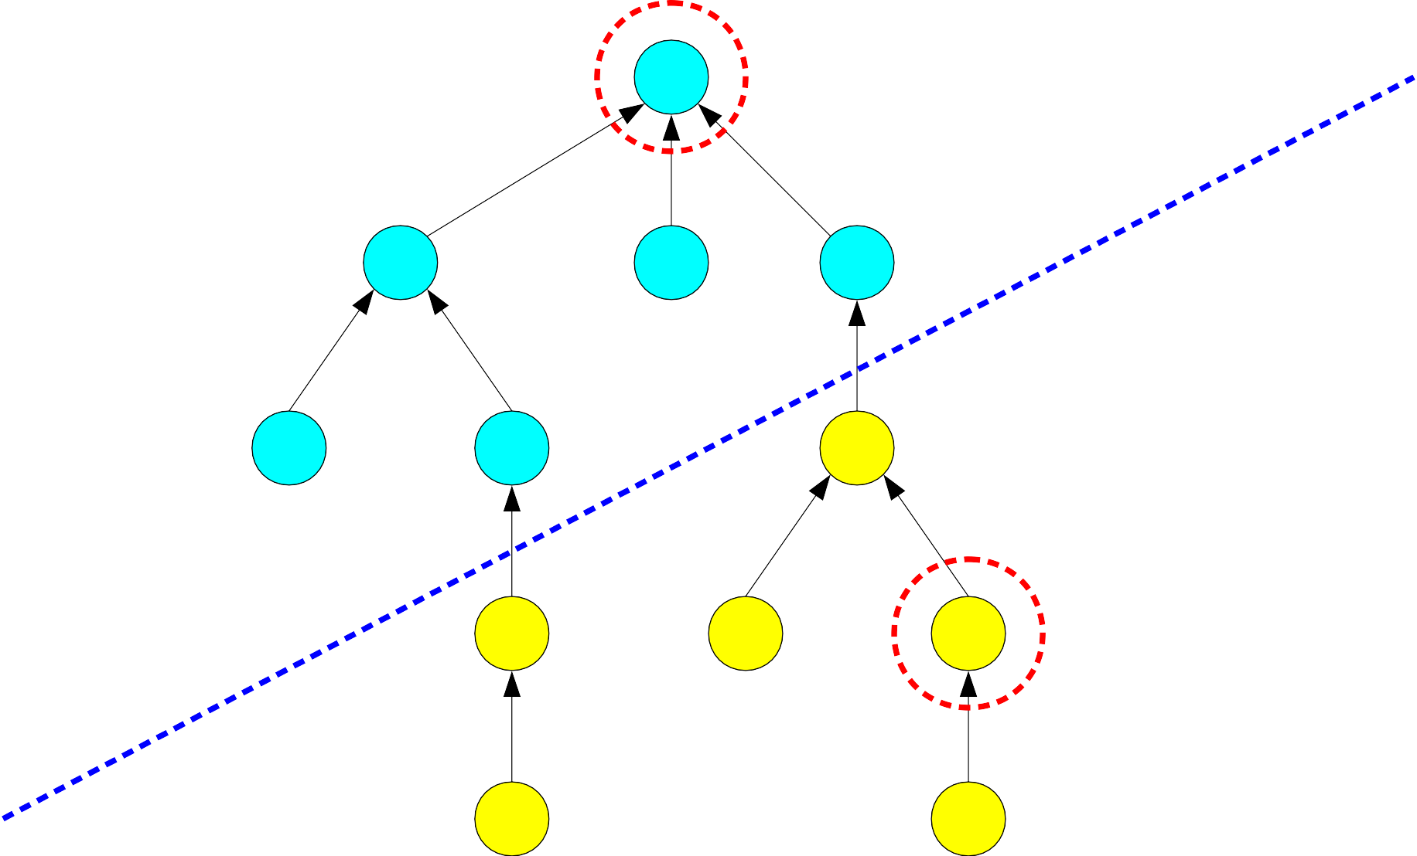
Forest-Slicing
a
b
c
d
e
f
g
h
i
j
k
l

Slide 147
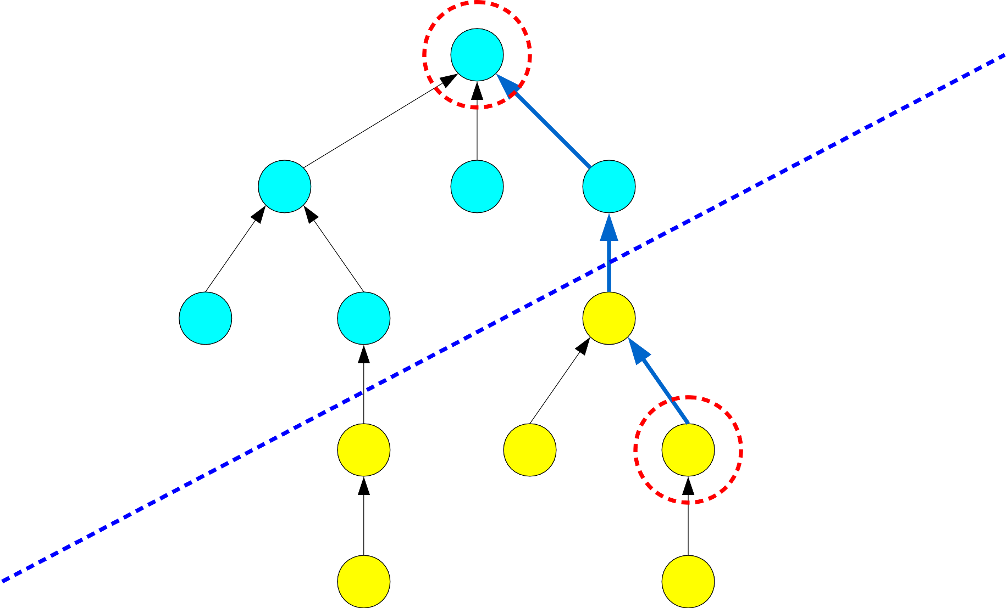
Forest-Slicing
a
b
c
d
e
f
g
h
i
j
k
l

Slide 148
Forest-Slicing
a
b
c
d
e
f
g
h
i
j
k
l

Slide 149
Forest-Slicing
a
b
c
j g
d
e
f
l i
h
k

Slide 150
Forest-Slicing
a
b
c
j g
d
e
f
l i
Nodes from ℱ₋ never move into ℱ₊ or vice- versa. We retain the original cut after doing compressions.
h
k

Slide 151
Why Slice Forests?

Slide 152
Forest-Slicing
●
Key insight: Each compress operation is either
purely in ℱ₊, purely in ℱ₋, or
crosses from ℱ₋ into ℱ₊.
●
●
●
●
If we can bound the cost of compress operations that cross from ℱ₋ to ℱ₊, we can try to set up a recurrence relation to analyze the cost of those compresses.

Slide 153
a
b c d e f g

Slide 154
a
b c d e f g

Slide 155
a
a
b
b
c
c
d
d
e
e
f
f
g
g

Slide 156
a
a
b c
b
c
d e f
d
g
e
f
g

Slide 157
a
a
b c
b
c
d e f
d
g
e
f
g

Slide 158
a
a
b c
b c
d e f
d
g
e
f
g

Slide 159
a
a
b c
b c
d e f
d
g
e
Observation 1: The portion of the compression in ℱ₊ is equivalent to a compression of the first node in ℱ₊ on the compression path to the last node in ℱ₊ on the compression path.
f
g

Slide 160
a
a
b c
b c
d e f
d
g
e
f
g

Slide 161
a
a
b c
b c
d e f
d
g
e
f
g

Slide 162
a
a
b c
b c
d e f
d
g
e
f
g

Slide 163
a
a
b c
b c
d e f
d
g
e
f
g

Slide 164
a
a
b c
b c
d e f
d e f
g
g

Slide 165
a
a
b c
b c
d e f
d e f
g
g
Observation 2: The effect of the compression on ℱ₋ is not the same as the effect of compressing from the first node in ℱ₋ to the last node in ℱ₋.

Slide 166
a
a
b c
b c
d e f
d e f
g
g
Observation 3: The cost of the compress in ℱ₋ is the number of nodes in ℱ₋ that got a parent in ℱ₊, plus (possibly) one more for the topmost node in ℱ₋ on the compression path.

Slide 167
The Cost of Crossing Compressions
●
Suppose we do m compressions, of which m₊ of them cross from ℱ₋ into ℱ₊.
We can upper bound the cost of these compressions as the sum of the following:
●
●
the cost of all the tops of those compressions, which occur purely in ℱ₊;
the number of nodes in ℱ₋, since each node in ℱ₋ gets a parent in ℱ₊ for the first time at most once; and
m₊, since each compression may change the pointer of the topmost node on the path in ℱ₋.
●
●

Slide 168
Theorem: Let ℱ be a disjoint-set forest and let ℱ₊ and ℱ₋ be a partition of ℱ into top and bottom forests.
Then for any series of m compressions C, there exist two sequences of compressions
C₊, a series of m₊ compressions purely in ℱ₊; and
C₋, a series of m₋ compressions purely in ℱ₋, such that
  m₊ + m₋ = m
  cost(C) ≤ cost(C₊) + cost(C₋) + n + m₊

Slide 169
Theorem: Let ℱ be a disjoint-set forest and let ℱ₊ and ℱ₋ be a partition of ℱ into top and bottom forests.
Then for any series of m compressions C, there exist two sequences of compressions
C₊, a series of m₊ compressions purely in ℱ₊; and
C₋, a series of m₋ compressions purely in ℱ₋, such that
  m₊ + m₋ = m
  cost(C) ≤ cost(C₊) + cost(C₋) + n + m₊
Compressions that appear purely in ℱ₊ or purely in ℱ₋, plus the tops of crossing compressions.

Slide 170
Theorem: Let ℱ be a disjoint-set forest and let ℱ₊ and ℱ₋ be a partition of ℱ into top and bottom forests.
Then for any series of m compressions C, there exist two sequences of compressions
C₊, a series of m₊ compressions purely in ℱ₊; and
C₋, a series of m₋ compressions purely in ℱ₋, such that
  m₊ + m₋ = m
  cost(C) ≤ cost(C₊) + cost(C₋) + n + m₊
Compressions that appear purely in ℱ₊ or purely in ℱ₋, plus the tops of crossing compressions.
Nodes in ℱ₋ getting their first parent in ℱ₊

Slide 171
Theorem: Let ℱ be a disjoint-set forest and let ℱ₊ and ℱ₋ be a partition of ℱ into top and bottom forests.
Then for any series of m compressions C, there exist two sequences of compressions
C₊, a series of m₊ compressions purely in ℱ₊; and
C₋, a series of m₋ compressions purely in ℱ₋, such that
  m₊ + m₋ = m
  cost(C) ≤ cost(C₊) + cost(C₋) + n + m₊
Compressions that appear purely in ℱ₊ or purely in ℱ₋, plus the tops of crossing compressions.
Nodes in ℱ₋ getting their first parent in ℱ₊
Nodes in ℱ₋ having their parent in ℱ₊ change.

Slide 172
The Main Analysis

Slide 173
Where We Are
●
We now have a sort of recurrence relation for evaluating the runtime of a series C of m compresses on an n-node forest ℱ sliced into ℱ₊ and ℱ₋:
cost(C) ≤ cost(C₊) + cost(C₋) + n + m₊
This recurrence relation assumes that we already know how we've sliced ℱ into ℱ₊ and ℱ₋.
To complete the analysis, we're going to need to precisely quantify what happens if we slice the forest in a number of different ways.
●
●

Slide 174
Natural Slices
●
One “natural” way to slice a forest ℱ into ℱ₊ and ℱ₋ is to pick some threshold rank. We then choose ℱ₊ to be all the nodes whose rank is above the threshold and ℱ₋ to be all the other nodes.
3 3
2
2
1
1
1
1
0
0
0
0
0
0
0
0
0

Slide 175
Natural Slices
●
One “natural” way to slice a forest ℱ into ℱ₊ and ℱ₋ is to pick some threshold rank. We then choose ℱ₊ to be all the nodes whose rank is above the threshold and ℱ₋ to be all the other nodes.
3 3
2
2
1
1
1
1
0
0
0
0
0
0
0
0
0

Slide 176
Natural Slices
●
One “natural” way to slice a forest ℱ into ℱ₊ and ℱ₋ is to pick some threshold rank. We then choose ℱ₊ to be all the nodes whose rank is above the threshold and ℱ₋ to be all the other nodes.
3 3
2
2
1
1
1
1
0
0
0
0
0
0
0
0
0

Slide 177
Natural Slices
●
One “natural” way to slice a forest ℱ into ℱ₊ and ℱ₋ is to pick some threshold rank. We then choose ℱ₊ to be all the nodes whose rank is above the threshold and ℱ₋ to be all the other nodes.
3 3
2
2
1
1
1
1
0
0
0
0
0
0
0
0
0

Slide 178
Natural Slices
●
If our initial forest has maximum rank r and we slice the forest at rank r', the bottom forest has maximum rank r' and the top forest is (essentially) a forest of rank r – r'.
3 3
2
2
1
1
1
1
0
0
0
0
0
0
0
0
0

Slide 179
Natural Slices
●
If our initial forest has maximum rank r and we slice the forest at rank r', the bottom forest has maximum rank r' and the top forest is (essentially) a forest of rank r – r'.
1 1
0
0
1
1
1
1
0
0
0
0
0
0
0
0
0

Slide 180
Slicing our Forest
●
Imagine that we have our forest ℱ of maximum rank r.
Suppose we cut slice the forest into ℱ₊ and ℱ₋ at some rank r'.
We know that
cost(C) ≤ cost(C₊) + cost(C₋) + n + m₊.
Let's investigate cost(C₊) and cost(C₋) independently.
●
●
●

Slide 181
The Top Forest
●
Let's begin by thinking about cost(C₊), the cost of compresses in the top forest ℱ₊.
Recall: ℱ₊ consists of all nodes of rank r'or higher.
Intuitively, we'd expect there to not be “too many” nodes in the top forest, since it's exponentially harder to get nodes of progressively harder orders.
Using our lemma from before, we know that there can be at most n / 2^{r'} nodes in ℱ₊.
Therefore, using our (weak) bound from before, we see that
cost(C₊) ≤ nr / 2^{r'}.
●
●
●
●

Slide 182
Slicing our Forest
●
Imagine that we have our forest ℱ of maximum rank r.
Suppose we cut slice the forest into ℱ₊ and ℱ₋ at some rank r'.
We know that
cost(C) ≤ cost(C₊) + cost(C₋) + n + m₊.
Therefore
cost(C) ≤ nr / 2^{r'} + cost(C₋) + n + m₊.
Let's now go investigate cost(C₋).
●
●
●
●

Slide 183
Improving our Recurrence
cost(C) ≤ nr / 2^{r'} + cost(C₋) + n + m₊.
Notice that cost(C) is the cost of
●
doing m compresses, in an n-node forest, with maximum rank r.
●
●
●
●
We now have cost(C₋), which is the cost of
doing m₋ compresses,
in a forest with at most n nodes, with maximum rank r'.
●
●
●
●
Let's make these dependencies more explicit.

Slide 184
Improving our Recurrence
cost(C) ≤ nr / 2^{r'} + cost(C₋) + n + m₊.
Define T(m, n, r) to be the cost of
●
performing m compress operations, in a forest of at most n nodes, where the maximum rank is r.
●
●
●
The above recurrence can be rewritten as T(m, n, r) ≤ T(m₋, n, r') + nr / 2^{r'} + n + m₊
Now, we “just” need to solve this recurrence. Don't worry... it's not too bad!
●
●

Slide 185
Finalizing our Recurrence
T(m, n, r) ≤ T(m₋, n, r') + nr / 2^{r'} + n + m₊
The above recurrence is dependent on having a choice of r' based on our choice of r.
If we make r' too large, then the recurrence relation takes too long to bottom out and we'll expect a higher runtime.
If we make r' too small, the nr / 2^{r'} term will be too large and our analysis won't be tight.
How do we balance these terms out?
●
●
●
●

Slide 186
Finalizing our Recurrence
T(m, n, r) ≤ T(m₋, n, r') + nr / 2^{r'} + n + m₊
Idea: Choose r' = lg r. Then
T(m, n, r) ≤ T(m₋, n, lg r) + 2n + m₊.
Imagine that this recurrence expands out L times before it bottoms out. Think about what happens:
●
●
The 2n term gets summed in L times.
The m₊ term – the number of compresses in the top forest – sums up to at most m across all compressions.
●
●
Overall, we get T(m, n, r) ≤ 2nL + m.

Slide 187
Iterated Logarithms
●
We now have
T(m, n, r) ≤ 2nL + m.
The quantity L represents the number of layers in the recurrence, and at each step we have r dropping to lg r.
The iterated logarithm, denoted lg* n, is the number of times we can apply lg to n before it drops to some constant (say, 2). Therefore:
T(m, n, r) ≤ 2n lg* r + m.
And since the maximum rank is at most lg n, we see that the cost of performing m operations on an n-node forest is O(n lg* n + m).
●
●
●

Slide 188
Iterated Logarithms
●
The function lg n is the inverse of the function 2^{n}; that is, 2 × 2 × … × 2, n times.
The tetration operation, denoted ^{n}2, is given
...²
by ^{n} ₂ ₌ ₂² , with n copies of 2 in the tower of
exponents. It grows extremely quickly!
The function lg* n is the inverse of tetration. It grows extremely slowly!
Useful fact: lg* n ≤ 5 for any n less than or equal to the number of atoms in the universe.
●
●
●

Slide 189
Our Strategy
Let's recap, how we got here.
We begin with a forest ℱ of maximum rank r.
We sliced ℱ at rank lg r.
●
●
●

Slide 190
Our Strategy
Let's recap, how we got here.
We begin with a forest ℱ of maximum rank r.
We sliced ℱ at rank lg r.
●
●
●

Slide 191


Our Strategy
Let's recap, how we got here.
We begin with a forest ℱ of maximum rank r.
We sliced ℱ at rank lg r.
We (directly) obtained a weak bound on the cost of the compressions in the (small) forest ℱ₊.
●
●
Cost here: n
●
●

Slide 192


Our Strategy
Let's recap, how we got here.
We begin with a forest ℱ of maximum rank r.
We sliced ℱ at rank lg r.
We (directly) obtained a weak bound on the cost of the compressions in the (small) forest ℱ₊.
We recursively obtained a (good) bound on the cost of the compressions in the (larger) forest ℱ₋.
●
●
Cost here: n
●
●
●
Cost here: T(m₋, n, lg r)

Slide 193
Our Strategy
Let's recap, how we got here.
We begin with a forest ℱ of maximum rank r.
We sliced ℱ at rank lg r.
We (directly) obtained a weak bound on the cost of the compressions in the (small) forest ℱ₊.
We recursively obtained a (good) bound on the cost of the compressions in the (larger) forest ℱ₋.
We solved the recurrence to get the bound
T(m, n, r) ≤ 2n lg* r + m.
●
●
Cost here: n
●
●
●
●
Cost here: T(m₋, n, lg r)

Slide 194
Our Strategy
●
What could we do to tighten the runtime bound?
Option 1: Tighten the bound on the cost of the top forest.
Option 2: Slice the forest even lower to make the recursion tree shorter.
Cost here: n
●
●
Cost here: T(m₋, n, lg r)

Slide 195
Our Strategy
What could we do to tighten the runtime bound?
Option 1: Tighten the bound on the cost of the top forest.
Option 2: Slice the forest even lower to make the recursion tree shorter.
Cost here: n
●
Cost here: T(m₋, n, lg r)

Slide 196
Our Strategy
What could we do to tighten the runtime bound?
Cost here: n
●
Option 1: Tighten the bound on the cost of the top forest.
Option 2: Slice the forest even lower to make the recursion tree shorter.
Previously, we used our weak bound that the cost of any series of operations on n nodes in a forest of maximum rank r was at most nr. We now have a bound of 2n lg* r + m, which is much tighter.
Cost here: T(m₋, n, lg r)

Slide 197
Our Strategy
What could we do to tighten the runtime bound?
Option 1: Tighten the bound on the cost of the top forest.
Option 2: Slice the forest even lower to make the recursion tree shorter.
Cost here: n
●
Cost here: T(m₋, n, lg r)

Slide 198
Our Strategy
What could we do to tighten the runtime bound?
Cost here: n
Option 1: Tighten the bound on the cost of the top forest.
Option 2: Slice the forest even lower to make the recursion tree shorter.
If we have a tighter bound on the cost of the top forest, we can afford to have more nodes in the top forest at the same cost, so we can slice the bottom forest even deeper.
●
Cost here: T(m₋, n, lg r)

Slide 199
Slicing our Forest, Again
Imagine that we have a forest ℱ of maximum rank r.
Suppose we cut slice the forest into ℱ₊ and ℱ₋ at some rank r'.
We know that
cost(C) ≤ cost(C₊) + cost(C₋) + n + m₊.
Therefore
T(m, n, r) ≤ cost(C₊) + T(m, n, r') + n + m₊.
Let's investigate cost(C₊) using our previous analysis.
●
●
●
●
●

Slide 200
The Top Forest
●
Lemma: In an n-node forest ℱ of maximum rank r, if we split ℱ into ℱ₊ and ℱ₋ by cutting the forest at rank r', then cost(C₊) ≤ 2n lg* r / 2^{r'} + m₊.
Proof: There are n / 2^{r'} nodes in this forest and the maximum rank is at most r. The cost of performing m₊ compress operations here is therefore
2(n / 2^{r'}) lg* r + m₊.
Observation: Our previous bound was
rn / 2^{r'}.
We previously set r' = lg r because that was as low as we could go without cost(C₊) being too high. With our new bound, we can afford to make r' much lower.
●
●

Slide 201
Our Recurrence
●
We had
T(m, n, r) ≤ cost(C₊) + T(m₋, n, r') + n + m₊.
So we now have
T(m, n, r) ≤ T(m₋, n, r') + 2n lg* r / 2^{r'} + n + 2m₊.
Previously, we picked r' = lg r and ended up with a bound in terms of lg* r.
Now, we pick r' = lg* r. Then we have
T(m, n, r) ≤ T(m₋, n, lg* r) + 2n + 2m₊.
Using a similar analysis as before, if L is the number of layers in the recurrence, this solves to
T(m, n, r) ≤ 2nL + 2m.
●
●
●
●

Slide 202
Iterated Iteration
●
We have
T(m, n, r) ≤ 2nL + 2m,
where L is the number of layers in the iteration.
At each step, we shrink r to lg* r. The maximum number of times we can do this is denoted lg** r, so we have
T(m, n, r) ≤ 2n lg** r + 2m.
So the cost of any m operations is O(n lg** n + m).
●
●

Slide 203
Iterated Iterated Logarithms
●
The pentation operation is next in the family of fast- growing functions.
Just as tetration is iterated exponentiation, pentation is iterated tetration, so 2 pentated to the nth power, denoted _{n}2, is
●
2 ₎
₂₂...
(
( )
...
2
2
2
2
...
2
where there are ^{n}2 copies of the exponential towers. The function lg** n is the inverse of pentation. It grows
unbelievably slowly!
●

Slide 204
Our Strategy
Let's recap, how we got here.
We begin with a forest ℱ of maximum rank r.
We sliced ℱ at rank lg* r.
●
●
●

Slide 205
Our Strategy
Let's recap, how we got here.
We begin with a forest ℱ of maximum rank r.
We sliced ℱ at rank lg* r.
●
●
●

Slide 206
Our Strategy
Let's recap, how we got here.
We begin with a forest ℱ of maximum rank r.
We sliced ℱ at rank lg* r.
We (directly) obtained a weak bound on the cost of the compressions in the (small) forest ℱ₊.
●
●
Cost here: n + m₊
●
●

Slide 207
Our Strategy
Let's recap, how we got here.
We begin with a forest ℱ of maximum rank r.
We sliced ℱ at rank lg* r.
We (directly) obtained a weak bound on the cost of the compressions in the (small) forest ℱ₊.
We recursively obtained a (good) bound on the cost of the compressions in the (larger) forest ℱ₋.
●
●
Cost here: n + m₊
●
●
●
Cost here: T(m₋, n, lg* r)

Slide 208
Our Strategy
Let's recap, how we got here.
We begin with a forest ℱ of maximum rank r.
We sliced ℱ at rank lg* r.
We (directly) obtained a weak bound on the cost of the compressions in the (small) forest ℱ₊.
We recursively obtained a (good) bound on the cost of the compressions in the (larger) forest ℱ₋.
We solved the recurrence to get the bound
T(m, n, r) ≤ 2n lg** r + 2m.
●
●
Cost here: n + m₊
●
●
●
●
Cost here: T(m₋, n, lg* r)

Slide 209
Our Strategy
●
What could we do to tighten the runtime bound?
Option 1: Tighten the bound on the cost of the top forest.
Option 2: Slice the forest even lower to make the recursion tree shorter.
Cost here: n + m₊
●
●
Cost here: T(m₋, n, lg* r)

Slide 210
Our Strategy
What could we do to tighten the runtime bound?
Option 1: Tighten the bound on the cost of the top forest.
Option 2: Slice the forest even lower to make the recursion tree shorter.
Cost here: n + m₊
●
Cost here: T(m₋, n, lg* r)

Slide 211
Our Strategy
What could we do to tighten the runtime bound?
Cost here: n + m₊
●
Option 1: Tighten the bound on the cost of the top forest.
Option 2: Slice the forest even lower to make the recursion tree shorter.
Previously, we used our weak bound that the cost of any series of operations on n nodes in a forest of maximum rank r was at most 2n lg* r + m. We now have a bound of 2n lg** r + 2m, which is much tighter.
Cost here: T(m₋, n, lg* r)

Slide 212
Our Strategy
What could we do to tighten the runtime bound?
Option 1: Tighten the bound on the cost of the top forest.
Option 2: Slice the forest even lower to make the recursion tree shorter.
Cost here: n + m₊
●
Cost here: T(m₋, n, lg* r)

Slide 213
Our Strategy
What could we do to tighten the runtime bound?
Cost here: n + m₊
Option 1: Tighten the bound on the cost of the top forest.
Option 2: Slice the forest even lower to make the recursion tree shorter.
If we have a tighter bound on the cost of the top forest, we can afford to have more nodes in the top forest at the same cost, so we can slice the bottom forest even deeper.
●
Cost here: T(m₋, n, lg* r)

Slide 214
The Feedback Lemma
Lemma: Suppose we know that
T(m, n, r) ≤ 2n lg*^{(k)} n + km.
Then
T(m, n, r) ≤ 2n lg*^{(k+1)}n + (k+1)m.
Proof: Induction! Use the previous proof as a template: split the forest at rank lg*^{(k)} r, use the known bound to bound the cost of the top forest, and use recursion to bound the cost of the bottom forest. ■
●
●

Slide 215
The Final Steps
For any k ∈ ℕ, we have
T(m, n, r) ≤ 2n lg*^{(k)} r + km. We can upper-bound r at log n, so we have
T(m, n) ≤ 2n lg*^{(k)} n + km.
As n gets larger and larger, we can increase the value of
k to make the lg*^{(k)} n term at most some constant value.
Question: What is that k, as a function of n?
The Ackermann inverse function, denoted α(n), is α(n) = min{ k ∈ ℕ | lg^{*(k)} n ≤ 3 }
Theorem: The cost of performing any m operations on any n-node disjoint set forest using union-by-rank and path compression is O(n + mα(n)).
●
●
●
●
●
●

Slide 216
Intuiting α(n)
●
Imagine we want to define some function A such that
A(n, 0) = 2
A(n, 1) = 2 + 2 + … + 2 = 2n
A(n, 2) = 2 × 2 × … × 2 = 2^{n}.
A(n, 3) = 2^{2...²} = ^{n}2. (tetration)
A(n, 4) = ^{²...2}2 = _{n}2 . (pentation)
A(n, 5) doesn't have a name, but scares children.
●
●
●
●
●
●
●
The function A is called an Ackermann-type function. There are a number of different functions in this family, but they all (fundamentally) apply higher and higher orders of functions to the arguments.

Slide 217
Intuiting α(n)
●
Theorem: Asymptotically, the function α(n) is the inverse of A(n, n), hence the name “Ackermann inverse”.
Intuition:
●
lg n is the inverse of 2^{n}, which is A(n, 2).
lg* n is the inverse of ^{n}2 (tetration), which is A(n, 3). lg** is the inverse of _{n}2 (pentation), which is A(n, 4).
α(n) tells you how many stars you need to make lg*^{(k)} n drop to a constant, which essentially asks for which essentially asks for what order of operation you need to invert.
●
●
●
●
●
This function grows more slowly than any of the iterated logarithm families. It's so slowly-growing that an input to it that would make it more than, say, 10 can't even be expressed without inventing special notation for fast- growing numbers.

Slide 218
Intuiting α(n)
●
If you keep dividing by two, you should expect a log term.
If you keep taking logs, you should expect a log* term.
If you keep taking log*s, you should expect a log** term.
If you keep adding stars to your logs, you should expect an α term.
●
●
●

Slide 219
Some Notes on α(n)
●
The term α(n) arises in many different algorithms:
●
Range semigroup queries: there's a lower bound of α(n) on the cost of a query under certain algebraic assumptions.
Minimum spanning trees: the fastest known deterministic MST algorithm runs in time O(mα(n)) due to a connection to the above topic.
Splay trees: imagine you treat a splay tree as a deque. Hilariously, the best bound we have on the runtime of performing n deque operations is O(nα*(n)). It's suspected to be O(n), but this hasn't been proven.
●
●
●
α(n) and its variants are the slowest-growing functions that are routinely encountered in algorithms and data structures. And now you know where it comes from!

